Slide 1
Chess Masters
Analyzing the Game
Jake Allen
Read Wagar
Joe Sterchele
Jordan Wolfe

Slide 2
Why Chess?
Mutual interest in the game
Game analytics
Chess is known worldwide
People everywhere could benefit
New perspectives can be groundbreaking

Slide 3
Beginning Stages
Planned scraping from websites
Instead, looked for CSV
All chess games are in PGN
Parsed these files into R
Extensive cleaning in R

Slide 4
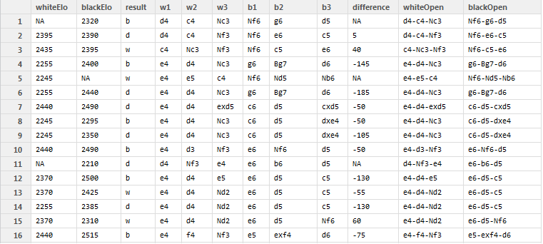
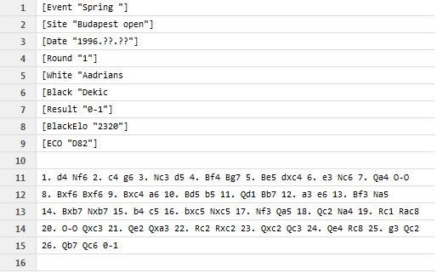
Raw Data in R
Raw Form
After Cleaning

Slide 5
What We Were Looking For
Elo Scores
How accurate is Elo score as a predictor for win percentage?
Opening Moves
Which openings are the most popular?
Which openings lead to winning?

Slide 6
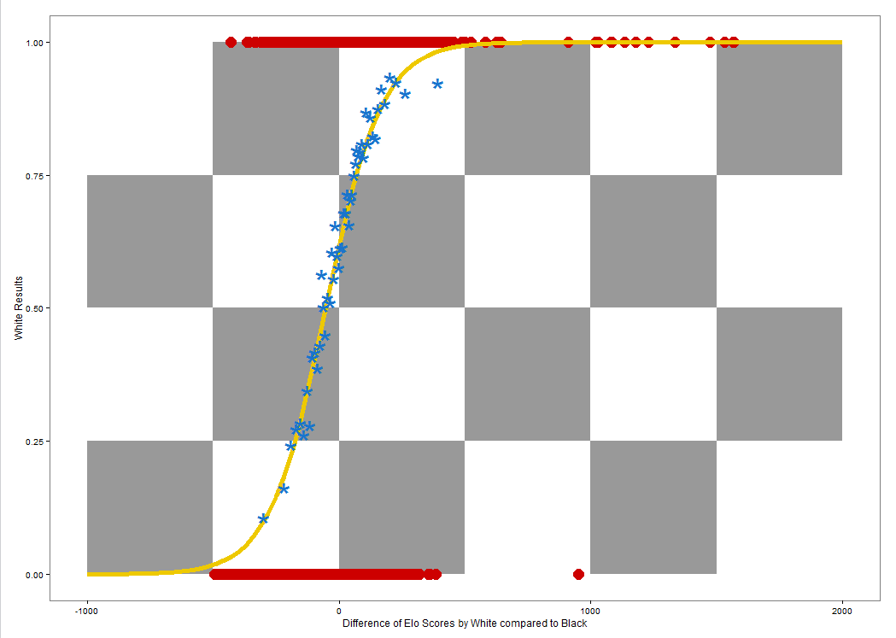
Results: Elo Score

Slide 7
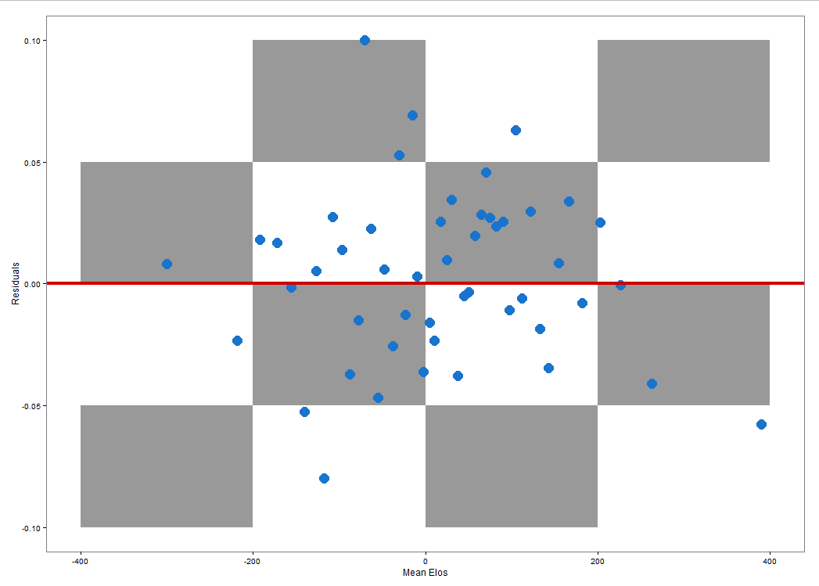
Results: Elo Score

Slide 8
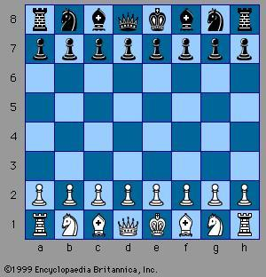
Openings

Slide 9
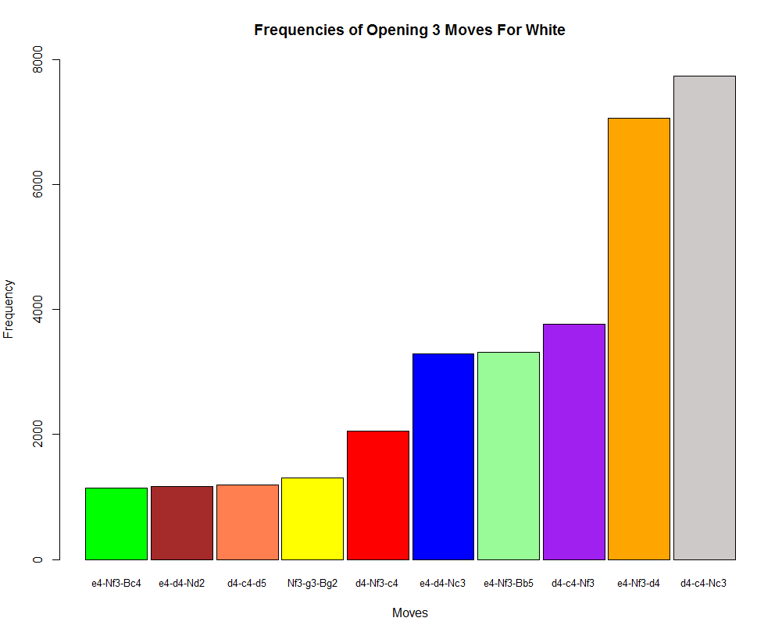
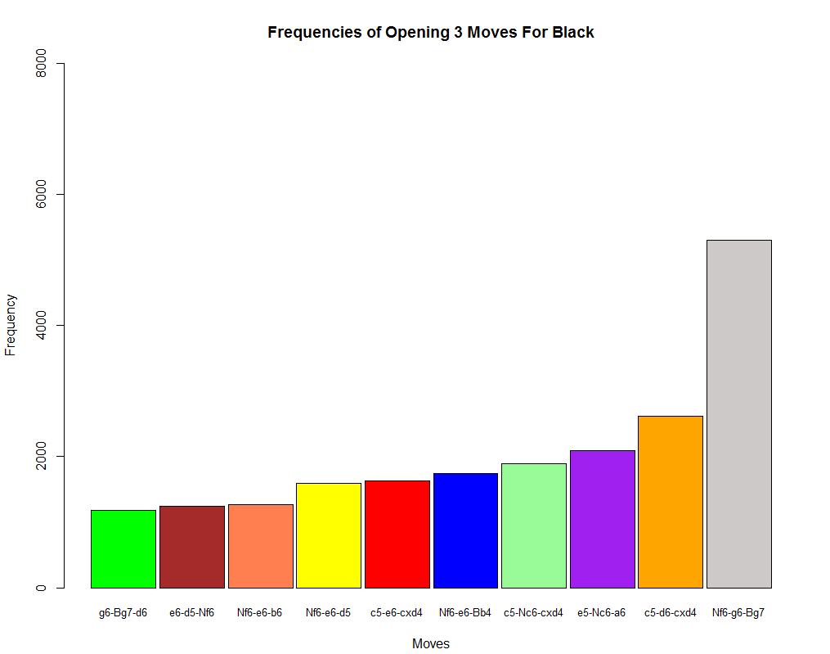
Results: Opening Moves

Slide 10
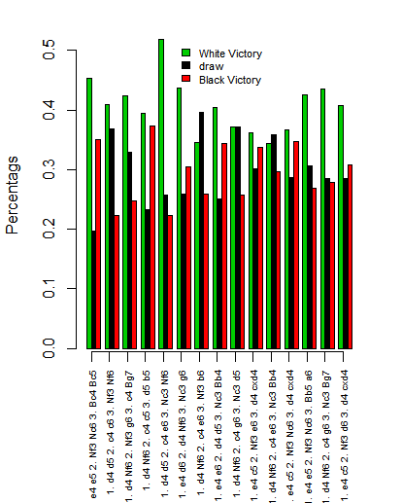
Results: Opening Moves
Percentages

Slide 11
Interactive Openings

Slide 12
Conclusions: Elo Score
Elo score is a pretty accurate win percentage predictor in chess.
Our results were similar to other research in player scoring

Slide 13
Conclusions: Opening Moves
If Elo scores are held constant, white has a 10% higher chance of winning over black
Other research hints at this
There is much debate on the topic

Slide 14
In the Future
Investigate the validity of Elo scores for other uses.
Map out the interactive graph for whole games
Split players by Elo scores

